Slide 1


Web scraping
Presented by: Hameed Emad Hameed And Ali Khalid Jabbar
UOITC

Slide 2



1
2
3
The code and an explanation of some important points
The web we used
Solve problems and explain the benefit of the project

Slide 3
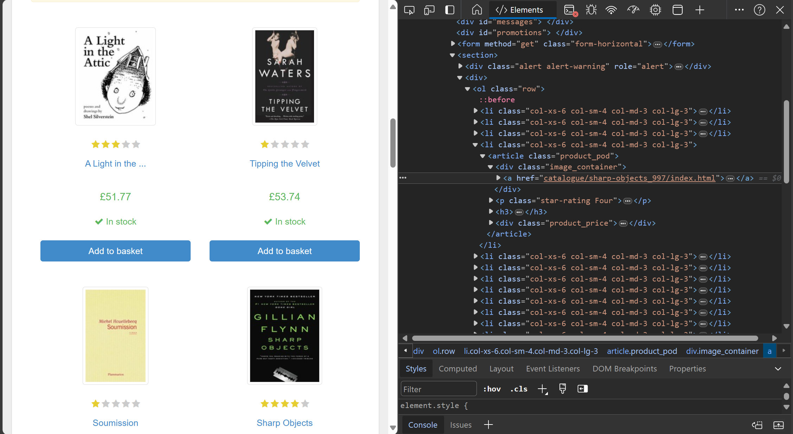

This is the main web page from which we extracted the data

Slide 4

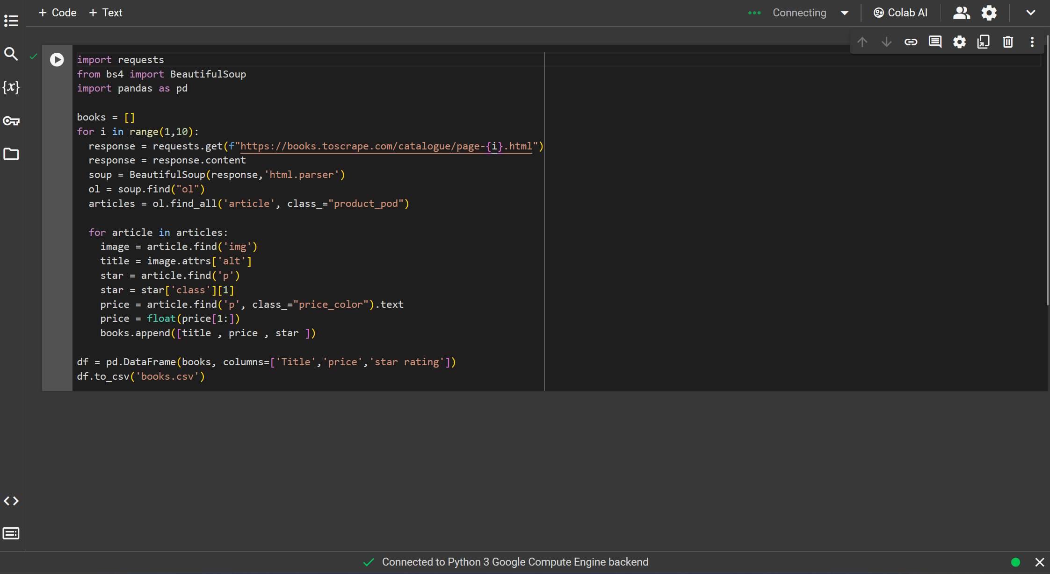
The code

Slide 5

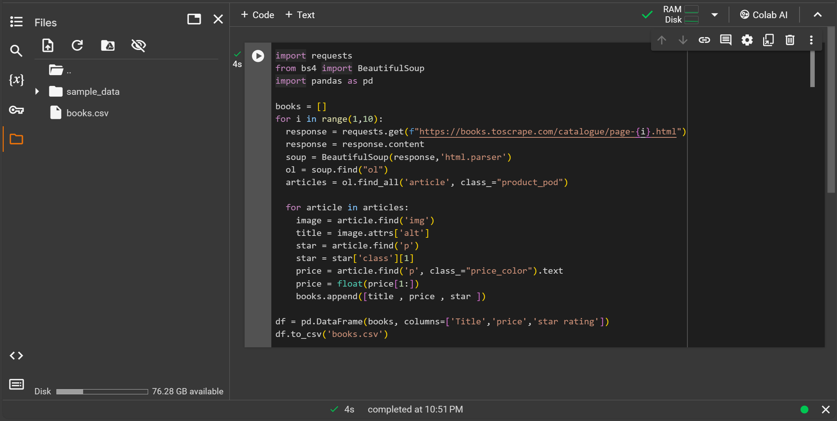
Program output

Slide 6
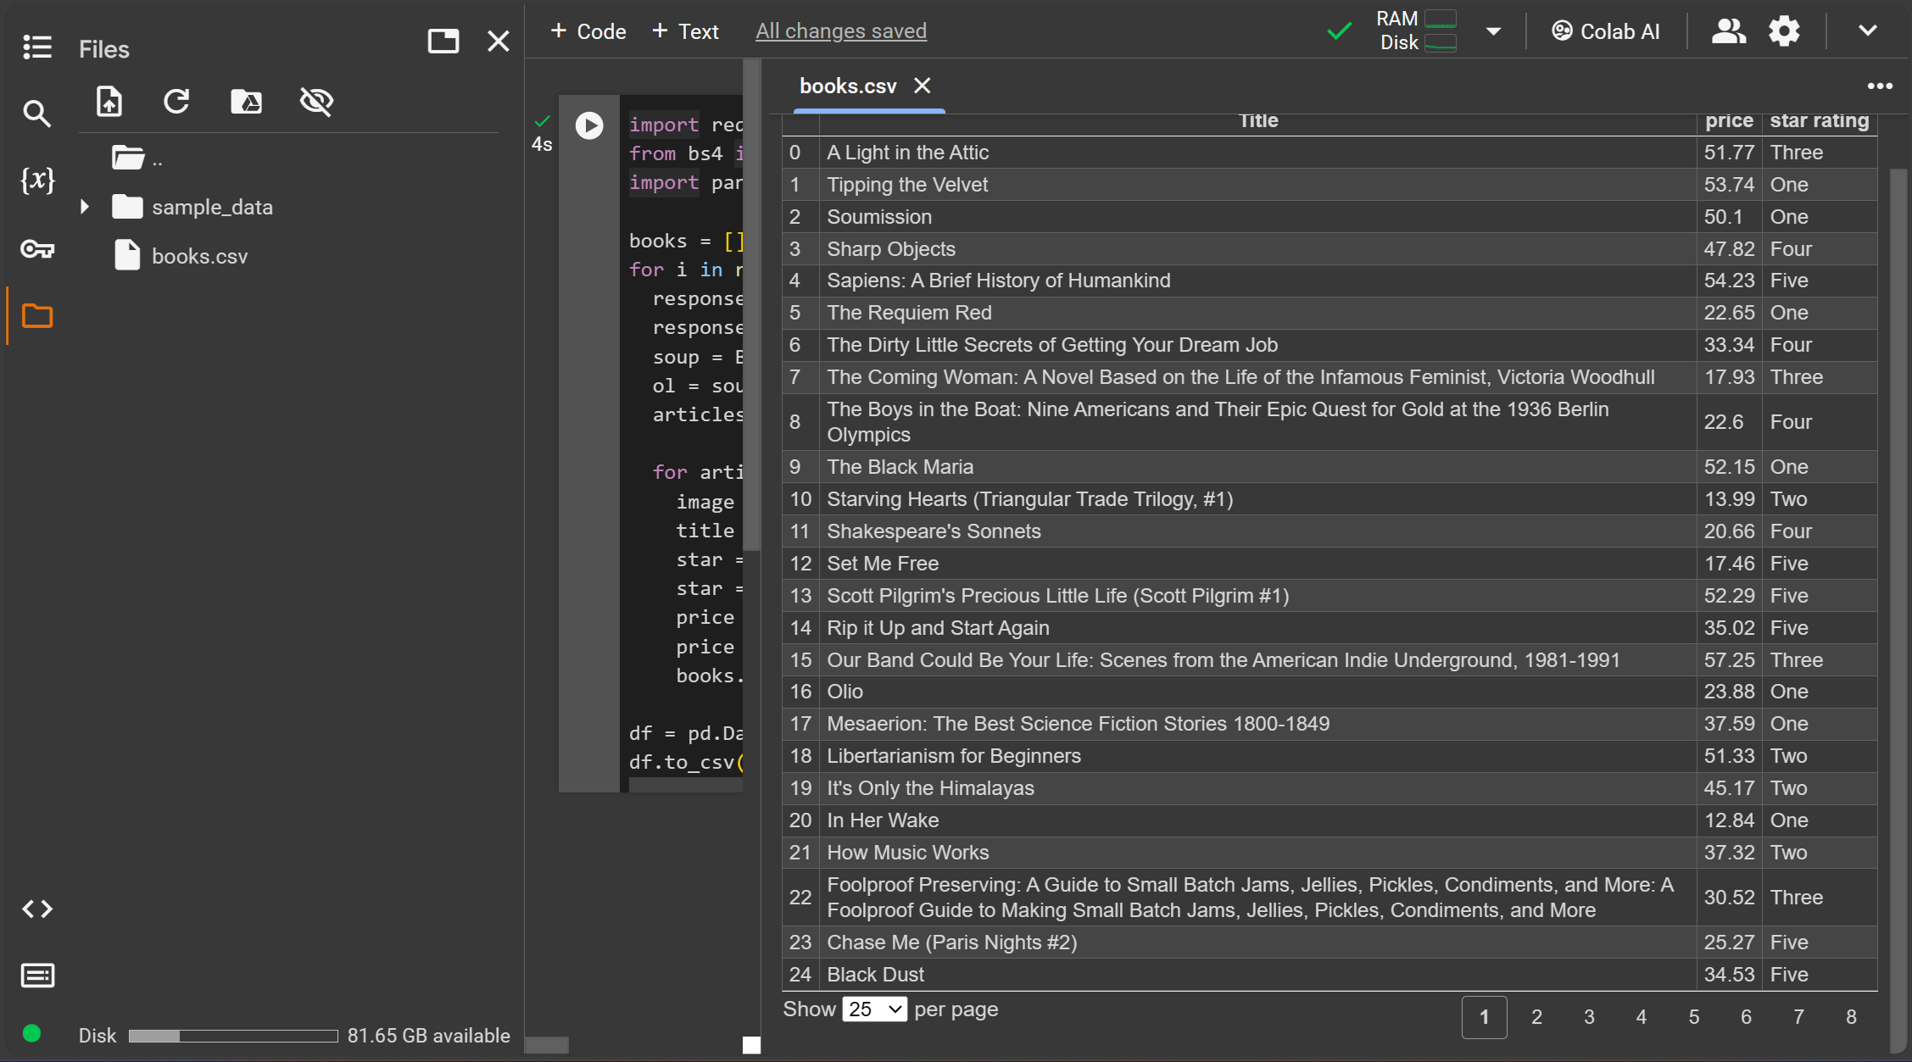

Program output

Slide 7
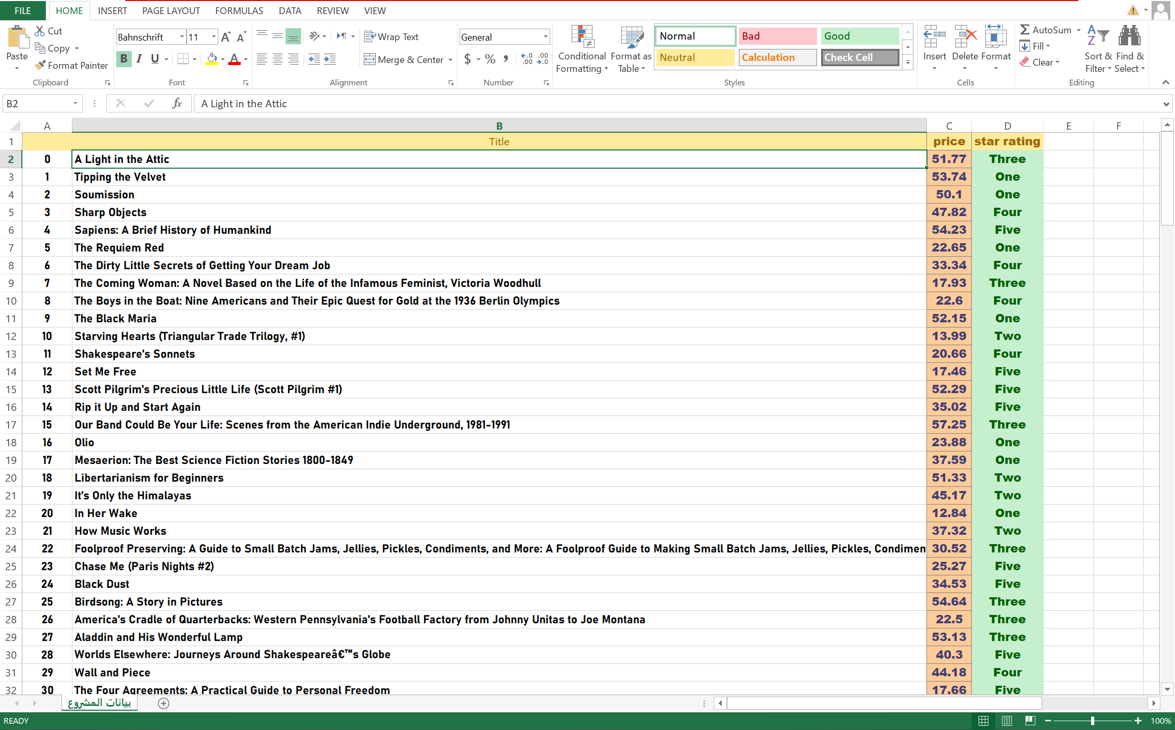

After extracting the data and placing it in a csv file, it is transferred to Excel to benefit from it more easily

Slide 8
Thanks
UOITC

